Slide 1
Unit 5 Meeting individual care and support needs
P4: Explain the strategies and communication techniques used with individuals different needs to overcome different challenges

Slide 2
Learning aims
To identify the challenges faced by individuals
To explain with examples the challenges faced by individuals
To identify the methods of identifying challenges
To explain with examples the methods of identifying challenges
To identify strategies to overcome challenges
To explain strategies to overcome challenges with examples
Assessment criteria: P4: Explain the strategies and communication techniques used with individuals different needs to overcome different challenges

Slide 3
What challenges are faced by service users?
Individuals with care and support needs face different types of challenges.
Think about an elderly service users what challenges could they face everyday?
Assessment criteria: P4: Explain the strategies and communication techniques used with individuals different needs to overcome different challenges

Slide 4
Challenges faced
Awareness and knowledge
Practical challenges
Skills challenges
Acceptance and belief challenges
Motivational challenges
Communication challenges
Assessment criteria: P4: Explain the strategies and communication techniques used with individuals different needs to overcome different challenges
Notes:
Write on big paper these 6 each table to take one
Write down what they think it means
Pass it on
Next groups look at text book sheets on computers – were they right? If they were wrong correct their work
Add an example of why this would be a challenge for an elderly person (expand on what has been said in the text book)
Pass it on – good example? Can they expand
Add an example related to one of the case studies
Pass it on – check through and share with the group
All students to take pictures of these

Slide 5
Practice
In your assignments you will need to explain each challenge and apply to a case study
You can do this for any case study and can use the same one for all if this is easier
In your books…Pick one of the challenges
Explain what it is
Apply to how it would be a challenge for the service user in your case study
Peer assess your work with a green pen
Assessment criteria: P4: Explain the strategies and communication techniques used with individuals different needs to overcome different challenges

Slide 6
Methods of identifying challenges
How do you think as a professional you could identify the challenges that the service users are facing? Discuss
Observation – looking at how the service user is behaving and identify what they might be finding difficult
Focus groups – small groups of people come together to discuss ideas and what might need to change to help people overcome challenges
Talking to individuals informally – talking to individuals using ‘normal’ language, but still asking questions to gain an idea of challenges
Using questionnaires – this allows for a setting to gain information from a lot of service users and see what common challenges may be
Assessment criteria: P4: Explain the strategies and communication techniques used with individuals different needs to overcome different challenges
Notes:
Go to text books and read make notes in books whilst reading
Go back and share findings – ask each group to explain one
Any questions about what they mean

Slide 7
Strategies to overcome challenges
When service users face challenges as professionals we need to be able to help them overcome these
How do you think we could overcome the challenges?
Challenges:
Awareness and knowledge
Practical challenges
Skills challenges
Acceptance and belief challenges
Motivational challenges
Communication challenges
Assessment criteria: P4: Explain the strategies and communication techniques used with individuals different needs to overcome different challenges
Notes:
Get students to look back at definitions and think about how they would try and support a service user to overcome the challenges

Slide 8
Strategies to overcome challenges
Educational information materials – leaflets, posters, DVD’s inform people on advice on how to overcome different challenges – awareness and knowledge, acceptance and beliefs
Training courses – this could apply to carers being trained to look after specific service users needs, could be used with the service user themselves. These are usually run by councils and hospitals – skills challenges, practical challenges
Opinion leaders – nominated person who has an influence in a particular area of health and social care they will be asked to speak on behalf of a number of service users to deal with challenges – awareness and knowledge, skills challenges
Clinical audits – review of care practice, this can help change practices that would then help services users overcome challenges – Communication challenges, practical challenges
Computer aided advice systems – online services which advise and guide service users in making decisions about their care – awareness and knowledge
Patient mediated strategies – information given to service users via mass media, this allows service users to have information to influence decisions that are made – motivational strategies
Assessment criteria: P4: Explain the strategies and communication techniques used with individuals different needs to overcome different challenges
Notes:
Students to be in six groups each group needs to produce a sheet for students to take notes on and they need to come up and teach this to the rest of the class

Slide 9
P4:
Introduction to this part of the assignment
1.Different types of challenges:
Explain and apply to one of your case studies
2.Methods to identify challenges: what are they, how can they be used in the case studies
3.Strategies to overcome challenges: what it is and how it could be used in your case study
Reuse the same examples from the first section.
Assessment criteria: P4: Explain the strategies and communication techniques used with individuals different needs to overcome different challenges

Slide 10
P4:
Introduction to this part of the assignment
Methods to identify challenges: what are they, how can they be used in the case studies
Different types of challenges:
Explain and apply to one of your case studies
Apply to a method: Observation – Alice could be observed in her home when professionals visit
Strategies to overcome challenges: what it is and how it could be used in your case study
Route one
Take a challenge: Practical challenges – Alice not being able to look after herself
Route two
Finally, apply a strategy to overcome: Training courses – helping Alice to know how to complete practical tasks
For this section you need to refer to all case studies but not for every single one. Each application just needs one case study
Assessment criteria: P4: Explain the strategies and communication techniques used with individuals different needs to overcome different challenges

Slide 11
Individual work
Look at the strategies – I want you to think about which case study you can apply to each one or all of them
Write down how this will relate
E.g. Maria – training course for carer to ensure needs are met
Assessment criteria: P4: Explain the strategies and communication techniques used with individuals different needs to overcome different challenges

Slide 12
Recap
P4 so far….
Challenges that service users face
Methods of identifying the challenges
How to overcome the challenges
What do you need to do?
Assessment criteria: P4: Explain the strategies and communication techniques used with individuals different needs to overcome different challenges

Slide 13
Homework
Research alternative forms of
communication that can be used with
service users.
Create a presentation or information sheet to
inform others on the types of alternative
communication
What they are
How they are used
Who they would be used with and why
Due date 21/11/2016
HINT: Look at your books and online specification to look at the alternative forms of communication you have to write about

Slide 14
Learning aims
To identify communication techniques
To explain the different approaches to communication
To identify types of communication
To explain types of communication
Assessment criteria: P4: Explain the strategies and communication techniques used with individuals different needs to overcome different challenges

Slide 15
Why do we communicate?
Discuss with your table why you think it is important to communicate

Slide 16
Approaches for effective communication
Psychoanalytical
What do you think these approaches might say about communication.
Think about what you know from psychology about them
Practice – take one theory and say how this would be used with a service user
Cognitive
Behavioural
Humanistic
Social
Assessment criteria: P4: Explain the strategies and communication techniques used with individuals different needs to overcome different challenges

Slide 17
Approaches
Approaches are used by professionals to think about how they should be communicating with a service user and addressing problems.
The different psychological approaches give different ways in which a professional can approach a problem with a service user and communicate effectively to overcome this.

Slide 18
Humanistic
Person centred
Allows people to feel like they have choices
The approach is unconditional but is based on trust with the service user
This approach to communicating ignores behaviour
It relies on the service user and professional having good communication skills

Slide 19
Behavioural
Only looks at observed behaviour
Doesn’t rely on good communication skills can be evidenced even in babies copying behaviour of adults
Natural approach – we all have behaviours
Can only be used to change behaviour
Doesn’t look at causes

Slide 20
Social
Looks at individuals in a social context
Uses experiments to understand behaviour
If someone is observing the service user in a social context it may alter the behaviour of the service user and others

Slide 21
Cognitive
Gives a structured way to understand behaviours and changes in behaviour
Takes notice of what the service user feels
Clearly allows the service user to express their thoughts
Relies on the service user being able to express their own feelings
Does not work with those who may have existing mental health problems

Slide 22
Psychoanalytical
Professional interprets what a service user does or says to mean something
Clear that the service user will understand why they behave in a certain way
Can be used for a number of problems and not just limited to behaviour changes
Specialist training required
Long time for results

Slide 23
Theories of communication
You will need to be in groups of 3
Take one of the theories each…
Argyle
Tuckman
Berner
You need to complete independent research to find out the following about the theories
When was the theory discovered or put into place
What is the theory
How can we apply this to health and social care
Create an information sheet which will clearly explain (in your own words) the theory to share with your group
Assessment criteria: P4: Explain the strategies and communication techniques used with individuals different needs to overcome different challenges

Slide 24
Types of communication
Verbal – explaining and presenting ideas clearly- CS
Non-verbal – body language, posture, facial expression, eye contact, gestures, personal space – 3 to CS
Written – good literacy skills, clear writing, clear structure and correct grammar - CS
Formal – used to demonstrate respect, addressing people by full name, usually used by professionals - CS
Informal – usually used when you know someone better or with family and friends. Communication we use on a day to day basis.
Assessment criteria: P4: Explain the strategies and communication techniques used with individuals different needs to overcome different challenges
Notes:
Look at books write down any you haven’t heard of before and their meanings
Think about how you could use them with your service users

Slide 25
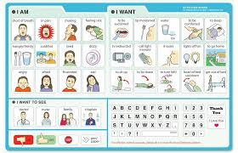
Alternative forms of communication
If we cannot communicate using verbal or non verbal communication what do we do?
Makaton
Braille
BSL
Communication boards
Symbol systems
Would any of these be used with a case study
Health and social care example

Slide 26
New technologies and communication techniques
Voice activated software – using a voice to move a wheelchair
Voice output communication aids – small movements into speech – Stephen Hawking used this
Mobile phones – texts and emails, hearing impairment can use vibration
Hearing aids – these have small microphones that pick up voices, noisy environments it does make other noises louder as well
Text relay service – charity run, an operator reads a message that someone has text in
Loop system – used in settings where there is a channel to set the hearing aid to hear what is being said
Braille software – creates braille printed in a special printer
Speech recognition – used by visually impaired to generate messages without using a keyboard
Assessment criteria: P4: Explain the strategies and communication techniques used with individuals different needs to overcome different challenges

Slide 27
P4:
Introduction to this part of the assignment
Strategies to overcome challenges: what it is and how it could be used in your case study
Methods to identify challenges: what are they, how can they be used in the case studies
Different types of challenges:
Explain and apply to one of your case studies
Types of communication
Explain each one
Apply formal and informal, 4 non -verbal to your case studies – how they would be used
Why do we communicate?
New technologies – 5 – what they are and who they would be used with?
Different approaches:
Explain and say how it would be used with case study
Alternative forms of communication
What they are
How they are used
Who you would use this with and why
Theories of communication
Explain all three and say how they could be used in health and social care
Apply one theory to one case study giving detailed example of how this would be used
Assessment criteria: P4: Explain the strategies and communication techniques used with individuals different needs to overcome different challenges

Slide 28
Learning aims
To identify what policy frameworks are
To explain what policy frameworks are
To identify the policy frameworks in Health and Social care
To explain the policy frameworks in Health and Social care
To explain how policy frameworks minimise the challenges service users face
Assessment criteria: P4: Explain the strategies and communication techniques used with individuals different needs to overcome different challenges

Slide 29
Role of policy frameworks in minimising challenges
Policy frameworks is a structure used to organise a set of principles and long term goals which include rules, guidance and an overall direction for planning and development. Many are used in the health and social care sector to reduce inequality of care. Some also include the ways in which we can assess needs and how to decide whether a service user is eligible for help. They are used to ensure that service users challenges are minimised and they are at lower risk of experiencing these challenges.
For your assignment you need to understand what they mean, how they help minimise the challenges we have covered and how they may be used with the service users in your case studies.
Assessment criteria: P4: Explain the strategies and communication techniques used with individuals different needs to overcome different challenges
Notes:
PRINT

Slide 30
Role of policy frameworks in minimising challenges
NHS Patient Experience Framework – including the eight elements
Health Action Plans
Adult Social Care Outcomes Framework (ASCOF)
Common Assessment Framework (CAF)
Assessment criteria: P4: Explain the strategies and communication techniques used with individuals different needs to overcome different challenges

Slide 31
NHS Patient Experience Framework
This sets out a definition of a positive patient experience built around the eight elements which make up good patient care.
Respect for patient centred values
Integration of care across the HSC system
Information and communication on clinical status
Physical comfort
Emotional support
Involvement of family and friends
Transition of care outside of HSC setting
Access to care – wait times

Slide 32
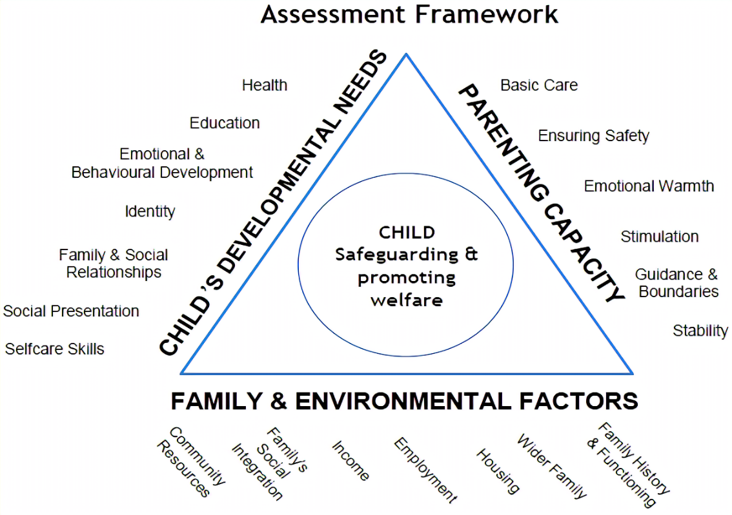
Common Assessment Framework (CAF)
Pre assessment checklist
It will help identify any problems or concerns
Aims to give early intervention before problems get worse
Parent and/or child have to give permission as it is a voluntary assessment
Have needs in one or more of the three areas on the sides of the triangle

Slide 33
Health action plans
Health Action Plans
The plans aim to minimise challenges by looking at what pressures the services may face.
Pressures are:
Ageing society
Long term conditions e.g. dementia
Increase in our expectations of the health service
Plans in place for obesity try and overcome challenges individuals may face and how the NHS deals with the service users.
Notes:
Research in threes textbooks and internet
What they are
How they are used
How do they minimise challenges

Slide 34
Adult Social Care Outcomes Framework (ASCOF)
(2011)
Measures performance of services against the aim of ensuring the most vulnerable people receive high quality care regardless of where they live.
It covers the following
Enhancing quality of life for people with care and support needs
Reducing the need for care and support
Positive experiences of care and support
Safeguarding adults that are vulnerable
Yearly reports for each local authority are given on this
This will help overcome challenges because it should provide support for all individuals regardless of who they are and where they live.

Slide 35
Impact of not enabling individuals to overcome challenges
It is difficult to ensure that all service providers know about the latest guidance in their particular field of care, what needs to change as a result of it and be motivated or accepting enough to make changes. Sometimes there are several sets of guidance coming from different bodies, which can make it hard to get service providers and users to engage wit the guidance. If service providers don’t make the changes, then service users aren’t able to make the changes necessary to improve their health and wellbeing. A challenge, such as the ageing population not being effectively tackled, could become a crisis in the future. The NHS could reach breaking point because it has reached its capacity, and the environments such as care homes may have to turn people away. Services and outcomes for service users wont improve, and early identification and intervention wont happen, which leads to a greater need for specialist services.
Assessment criteria: P4: Explain the strategies and communication techniques used with individuals different needs to overcome different challenges
Notes:
Read and highlight
Discuss what it is saying
Summarise in your own words

Slide 36
P4:
Different types of challenges:
Explain and apply to one of your case studies
Methods to identify challenges: what are they, how can they be used in the case studies
Strategies to overcome challenges: what it is and how it could be used in your case study
Why do we communicate?
Impact of not enabling service users to overcome challenges – write in your own words the impact
Different approaches:
Explain and say how it would be used with case study
Add a conclusion to your work saying why it is important to minimise the challenges that service users face
Policy framework
What they are, how they are used and how they minimise challenges
Types of communication
Explain each one
Apply formal and informal, 4 non -verbal to your case studies
Theories of communication
Explain all three and say how they could be used in health and social care
Apply one theory to one case study giving detailed example of how this would be used
Alternative forms of communication
What they are
How they are used
Who you would use this with and why
New technologies – 5 – what they are and who they would be used with?
Assessment criteria: P4: Explain the strategies and communication techniques used with individuals different needs to overcome different challenges

