Slide 1
Unit 5 P2/M2

Slide 2
Learning aims
To identify the skills and personal attributes necessary for professionals
To explain the skills and personal attributes necessary for professionals
To assess the importance of having these skills and personal attributes necessary for professionals

Slide 3
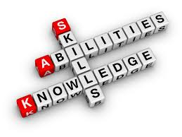
Assessment criteria
Today we are working - P2 – Explain the skills and personal attributes necessary for professionals who care for individuals with different needs

Slide 4
Definitions
Skill – the ability to do something well or to be expert in something
Personal attributes – qualities that make an individual who they are

Slide 5
Identify skills and personal attributes
What skills do you think you need to work in health and social care?

Slide 6
Identify skills and personal attributes
On your tables I have put different skills that you need to work in health and social care.
These are all what we call ‘people skills’
Pick a couple and write down what you think they mean

Slide 7
Explain skills and personal attributes
You need to take one ‘people skill’ each. You will each write on a coloured piece of paper.
Draw a quarter of a circle on your page.
Write down an example of using this with a service user
When you have finished share and stick these on

Slide 8
Skills
Patience
Honesty
Sense of humour
Empathy
Engendering trust
Problem solving skills
Flexibility
Negotiating skills

Slide 9
STRETCH: Assess the importance of having these skills on the service user
Continue to write on your poster sheet
Impact if we use them
Impact if we do not use them
Work as a group to add this to the outside of your ‘donut’

Slide 10
Identify skills and personal attributes
What communication skills do you think you need to work in health and social care?
Can you list some?
What do they mean?

Slide 11
Identify skills and personal attributes
You are going to look at three communication skills:
Active listening and responding
Tone of voice
Use of appropriate language

Slide 12
Active listening and responding
This is more than just listening this is really processing and understanding what someone is trying to communicate with you.
You can show this through how you act e.g. body language, facial expressions and eye contact
You should
allow someone time to speak
nodding, asking questions
ask for clarification
summarising at the end

Slide 13
Tone of voice
The way you say something can be really important
If you talk in a loud fixed tone someone may think you are angry
If you speak calmly they will think you are being friendly
You can vary your tone to reflect how you are feeling or how you want to come across

Slide 14
Use of appropriate language
You should adjust your language to suit the situation
We usually do this without realising it
If you speak to a friend on the phone you will speak differently than if you rang your GP
Professionals will also change their speech e.g. if they are talking to a child or adult

Slide 15
In your coursework
You will also need to refer to the skills of:
Questioning – asking someone questions to gain more information
Clarifying – making sure you understand by asking a question or repeating what you have heard
Responding to difficult situations – if you have good communication skills you will find it easier to develop relationships and deal with a difficult situation e.g. arguments between service users. What skills would help with this?

Slide 16
In your coursework
For each skill you will need to say how it would be beneficial to the case study using the key areas from the next slide

Slide 17
Good communication skills
Develop positive relationships with people using services and their families and friends, so that they can understand and meet their needs
Develop positive relationships with work colleagues and other professionals
Share information with people using the services, by providing and receiving information
Report on the work they do with people

Slide 18
Identify skills and personal attributes
What are observation skills in health and social care?
What may you need to observe in health and social care?

Slide 19
Explain skills and personal attributes
Explain what you would need to observe for two of your case studies – use below to apply to your case study
observing changes in an individual’s condition
monitoring children’s or someone's development
What condition may they have?
What parts of their development might you look at PIES?

Slide 20
Observing changes in an individual’s condition
Professionals may observe physical changes e.g. heart rate this is a measurable observation
Sometimes a professional may just observe a change that is not measureable e.g. change in mood

Slide 21
Monitoring children’s or someone's development
Children
It is important to watch children closely in how they change over time
This can be both physical conditions and learning disabilities
How could we apply this to adults?
Professionals can use observation skills to consider risk of abuse, hygiene issues in adults

Slide 22
Why should we observe individuals?
What would happen if you did not do what you have written about observation skills?
How does it benefit service users by having observation skills?

Slide 23
Why is it vital to have good communication skills?
Good communication skills are vital for people working in health and social care because….
Write three points down that will finish the sentence
Swap your work – what can you add to your peers work – use a green pen
Look at the sheet what else can you add to your notes – use green pen

Slide 24
Applying to your case studies
You all have a sheet to write up your work
This will help your structure for your assignment
It has all the skills we have covered so far for you to write about.
How you can apply this to one for your case studies – make sure you refer to the two throughout

Slide 25
Learning aims
To identify the 6 C’s
To be able to explain the 6 C’s and give examples of using them
To be able to assess the importance of the 6 C’s in Health and Social Care

Slide 26
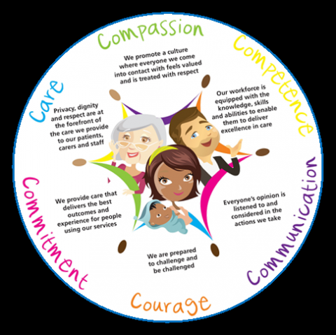
Identify the 6 C’s
Can you think of 6 words beginning with C that might tell us how to work in health and social care?
Compassion
Care
Competence
Communication
Courage
Commitment
Notes:
PRINT

Slide 27
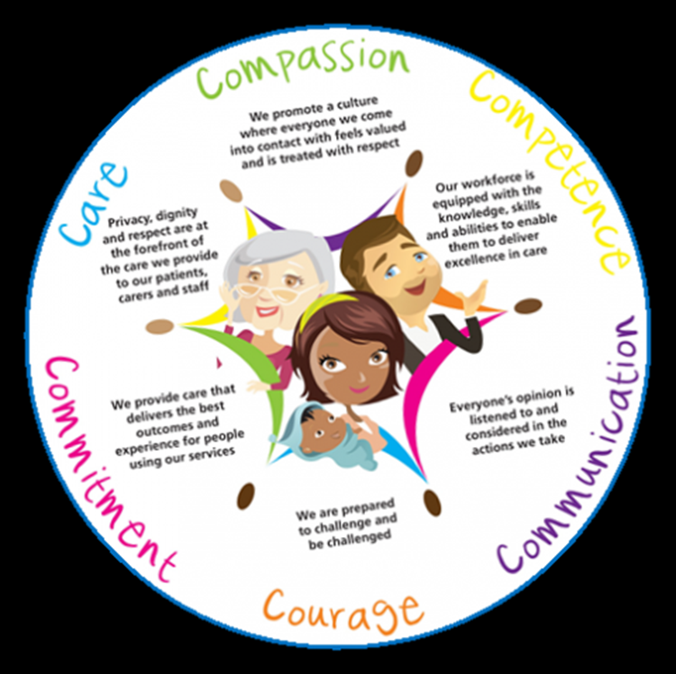

Slide 28
Explain the 6 C’s
Compassion
Care
Competence
Communication
Courage
Commitment
What do they mean?
Can you explain how you would use them?

Slide 29
6 C’s
‘Compassion in practice’ is a national strategy
Launched in Dec 2012
This was as a result of winterbourne view and mid Staffordshire hospital investigations – we will watch a clip now
After this the 6C’s started to be put in place

Slide 30
P2
Explain the 6 C’s
How they are used generally
Apply to your case studies – two of the C’s to each case study

Slide 31
Learning aims
To identify the methods used to develop relationships with individuals
To explain the methods used to develop relationships with individuals
To assess the methods used to develop relationships with individuals

Slide 32
What are the ways in which we develop our relationships with service users?
People skills
Communication skills
Observation skills
The 6 C’s
HINT: P2!

Slide 33
M2 – Assess different methods professionals might use when building relationships and establishing trust with individuals with needs
What do you think we need to do to meet M2?

Slide 34
M2 – Assess different methods professionals might use when building relationships and establishing trust with individuals with needs
Notes:
PRINT to write around

Slide 35
M2 – Assess different methods professionals might use when building relationships and establishing trust with individuals with needs
3 people skills
2 communication skills
1 observation skill
2 of the 6 C’s
Assess – Evaluate in terms of advantages and disadvantages
Methods – People skills, communication skills, observation skills, the 6 C’s
Individuals with needs are your service users in your case studies
Notes:
PRINT to write around

Slide 36
Pick your skills…
As I put on the previous slide you need to pick the skills you want to assess.
Think about the skills you understand the most and found easiest to apply to the case studies.
You will need to get four coloured bits of paper – on each one you need to write the titles of the skills

Slide 37
Assessing the methods used
3 people skills
2 communication skills
1 observation skill
2 of the 6 C’s
On your paper I want you to write down your ideas which will make up your assessment – you can work in pairs to do this
You are thinking about how effective the method is in building a relationship or how it may be ineffective or not improve the relationship.
For your disadvantage you can think about if it wasn’t used properly what would the impact be

Slide 38
Setting out your M2
Start of with an introduction – why is it important to develop a relationship and how skills can help this
People skills can help build relationships because….then go through your skills saying why it is a good or why it may not be effective in building a relationship with either of your case studies
Communication skills are also important in building relationships because…then go through your skills saying why it is a good or why it may not be effective in building a relationship with either of your case studies
All professionals need to observe service users to ensure that they are progressing as you would expect and that they do not need anything else to help with their care. In the case of….you could observe…
Two of the 6 C’s are….these can be used with all service users to try and encourage and build relationships. The first can be used with…..

